Slide 1
Frostgrave Companion
David Lein

Slide 2
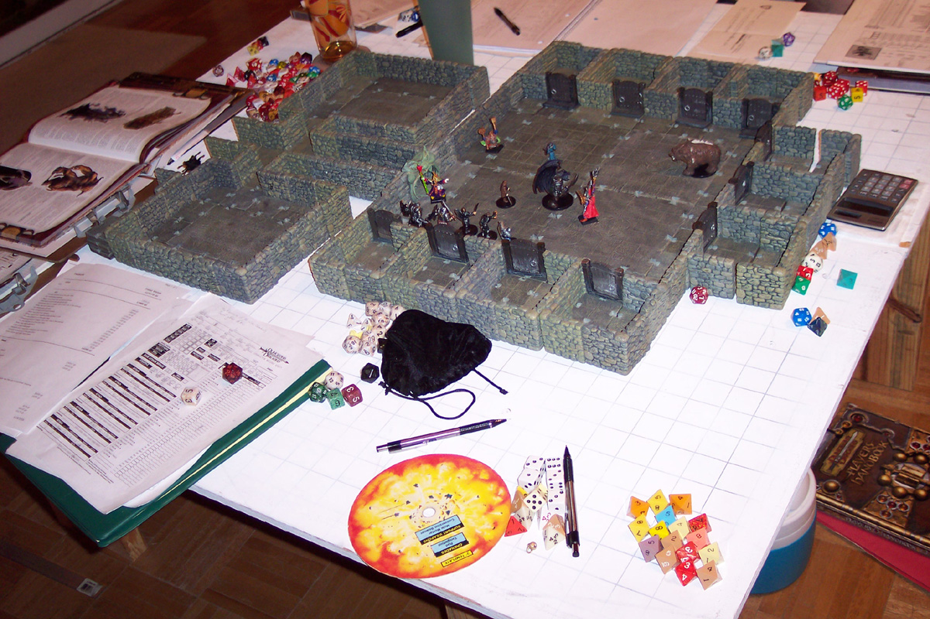
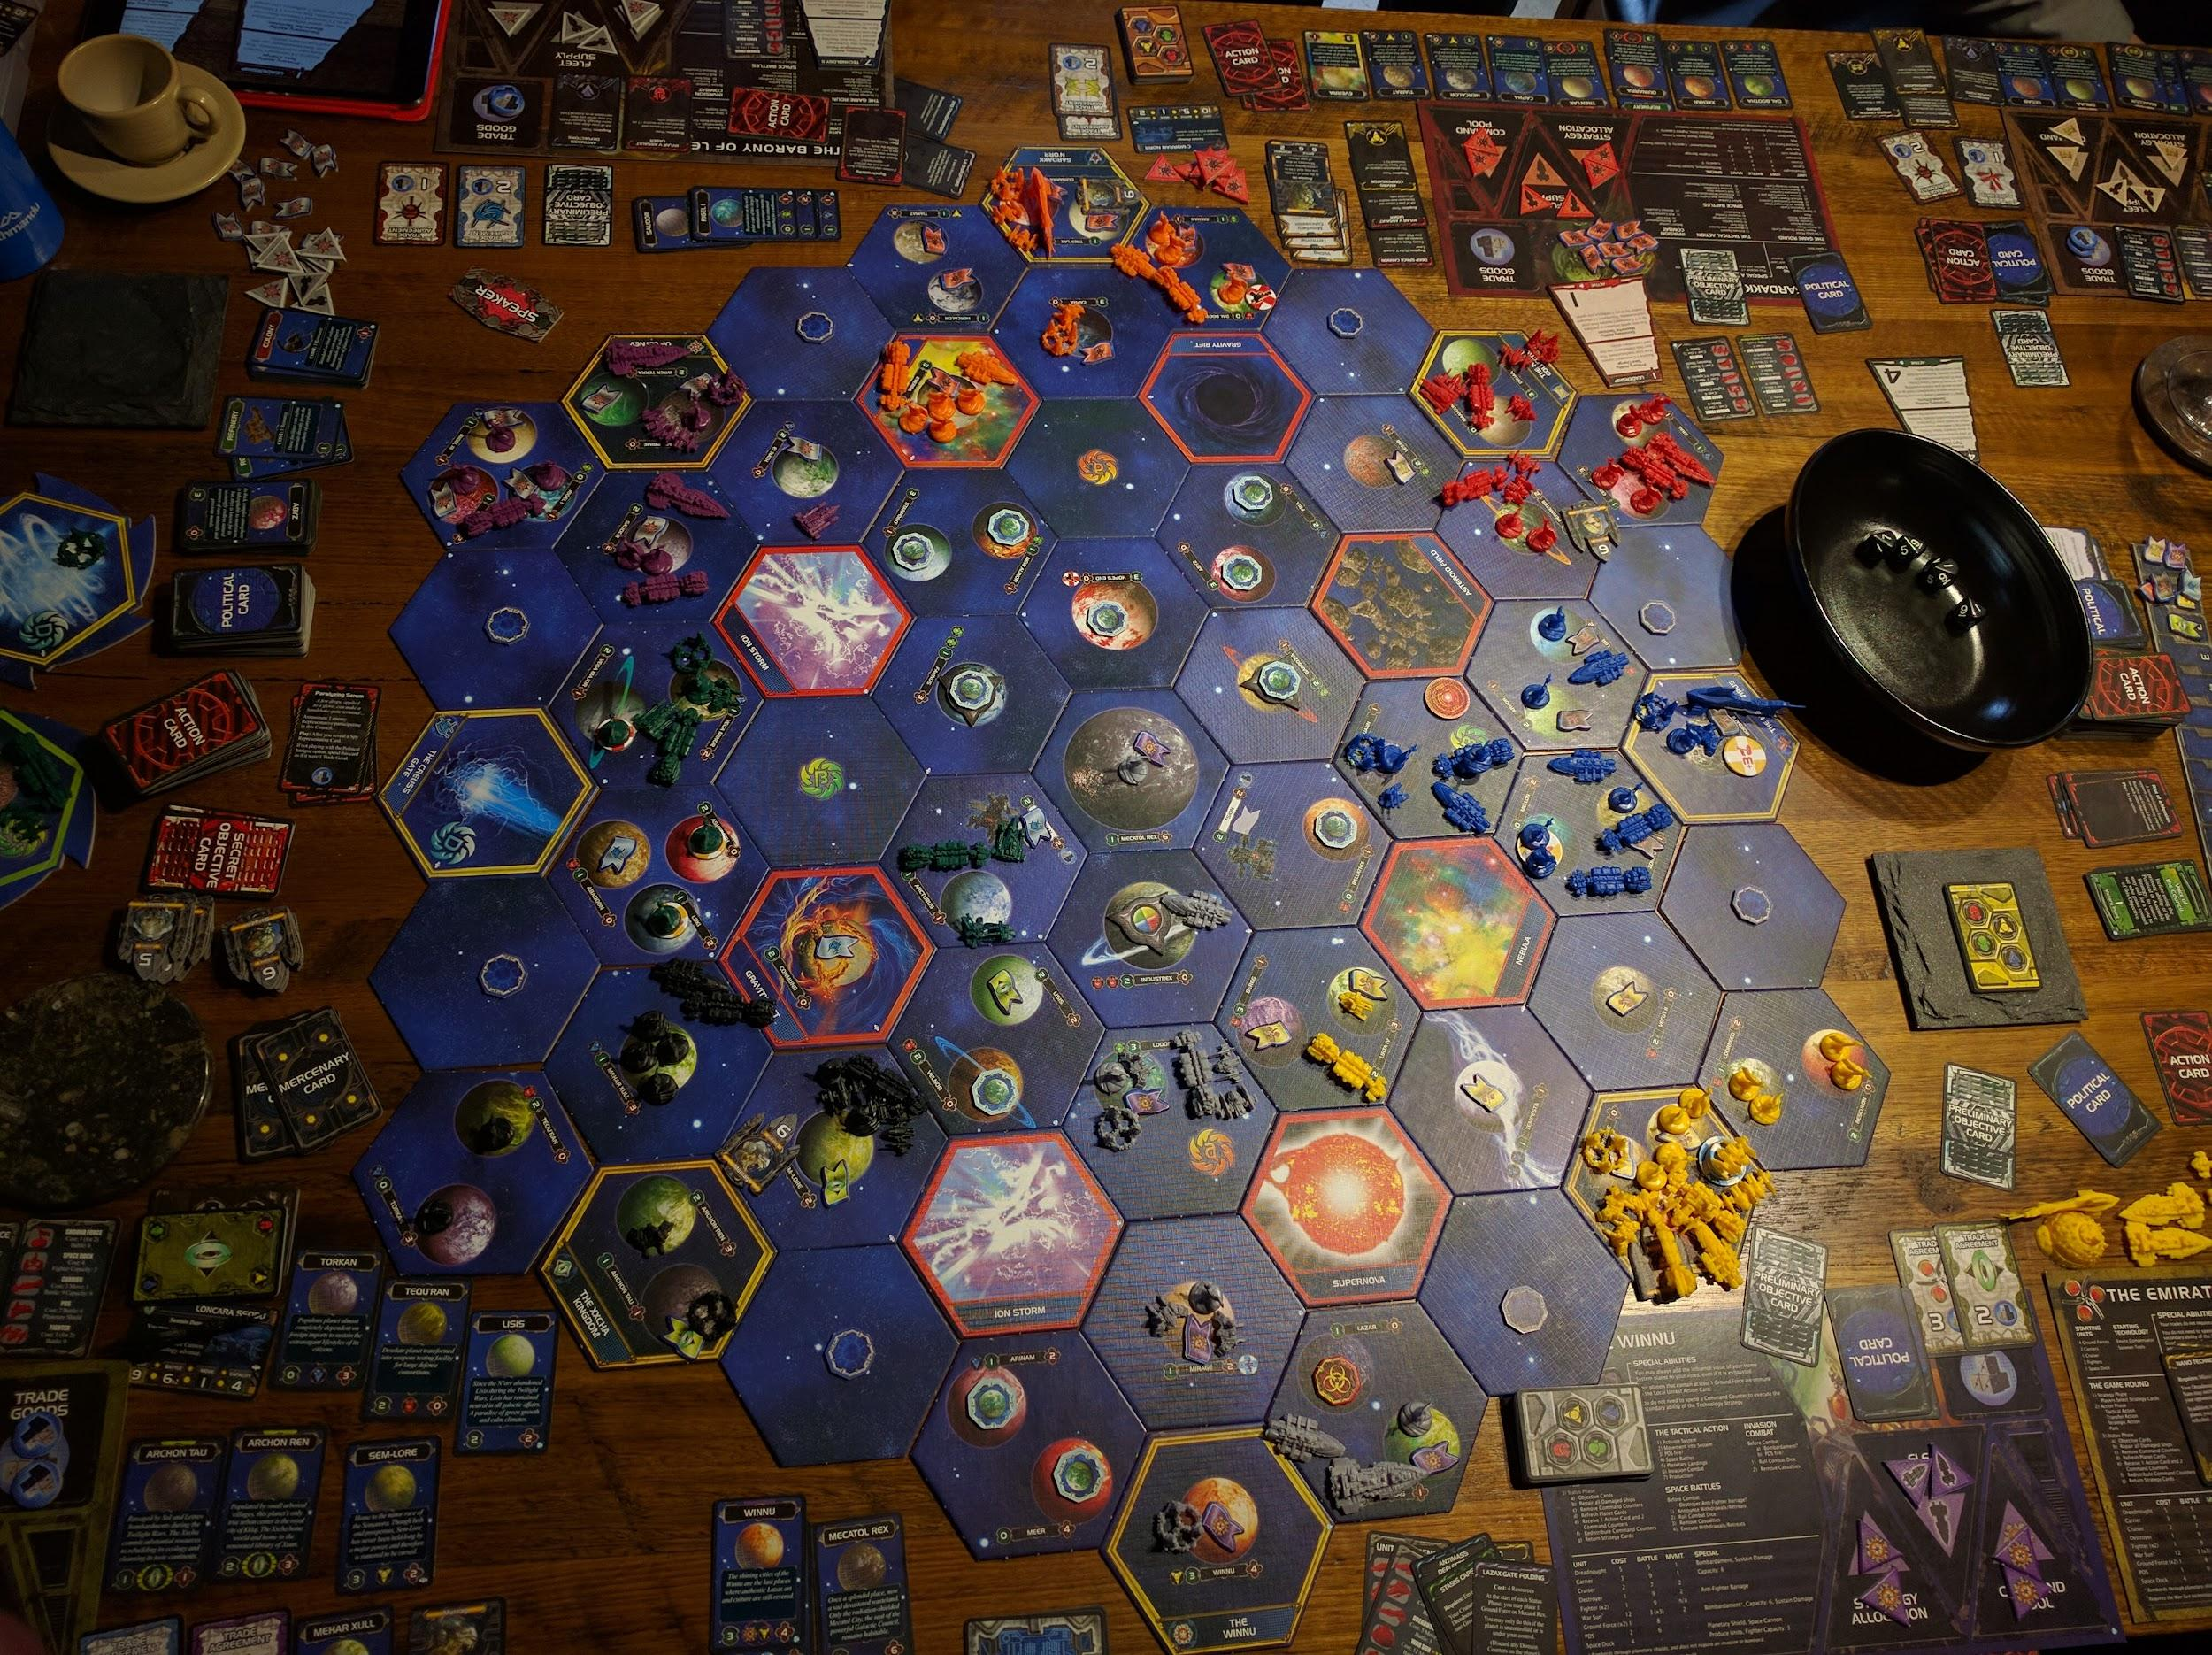
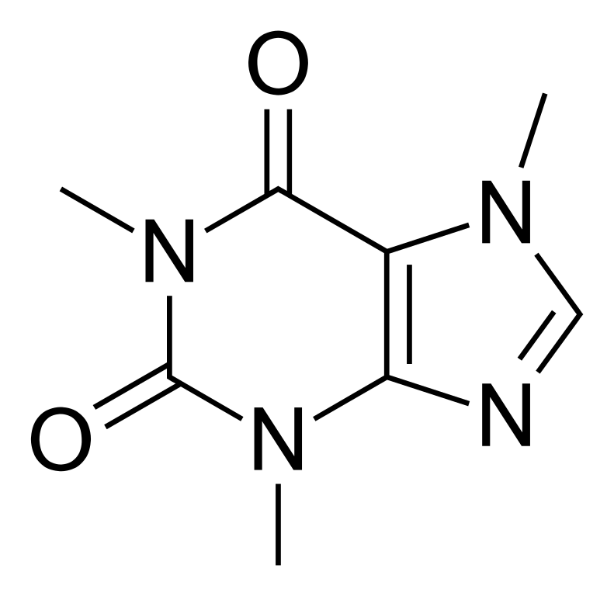
About Me
David Lein
Origin
Minnesota
Originally North Dakota
Education
Associate’s of Applied Science in Chemistry
Inver Hills Community College
No Coding
Work
Treasure Island
Sherwin-Williams
Hobbies
Tabletop Games
Board Games
Etc

Slide 3
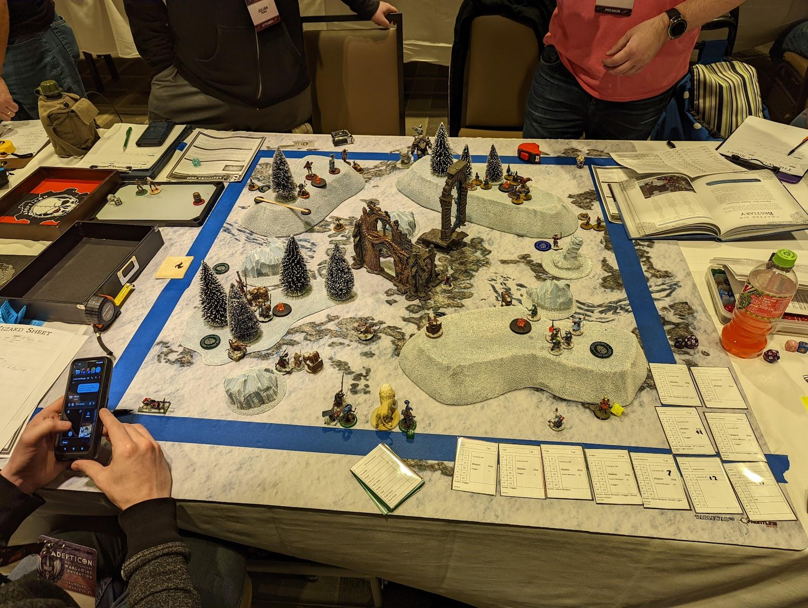
Background
What is Frostgrave?
Tabletop Skirmish
Tactical Combat
Fantasy
Gameplay
2 players (typically)
Approx. 2 hours to play
Campaign
Requirements
20-sided dice
Tape measure
Miniatures and terrain
Rulebook

Slide 4
Goals
Store warband data in database
Wizard
Apprentice
Soldiers
Translate the Wizard Sheet into digital format
Spells
Casting Values
Stat Blocks
Campaign information
Allow a user to track useful information
Campaign
Injuries
Wizard leveling
Base
Vault
Treasury
Per Scenario
Wizard XP
Health

Slide 5
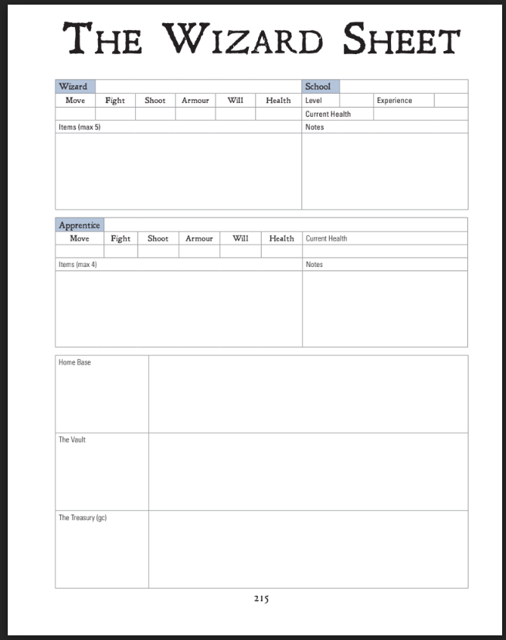
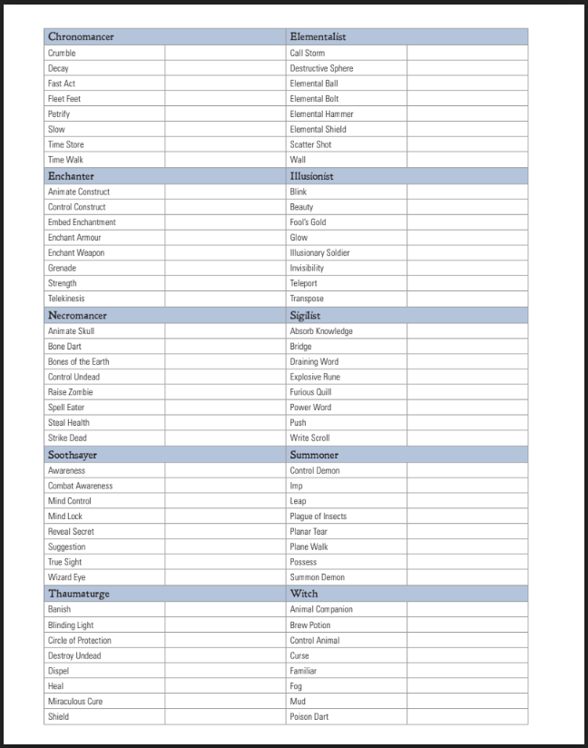
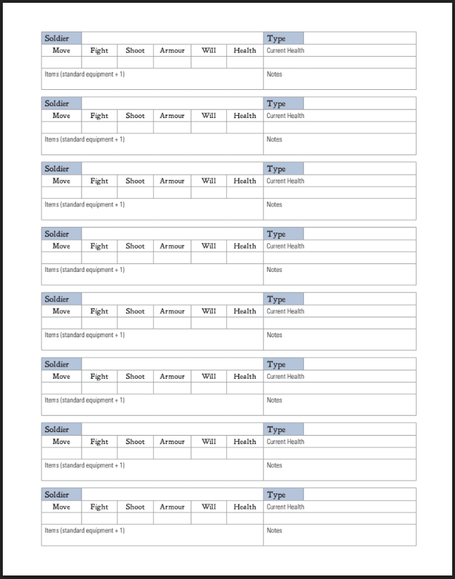
The Wizard Sheet

Slide 6
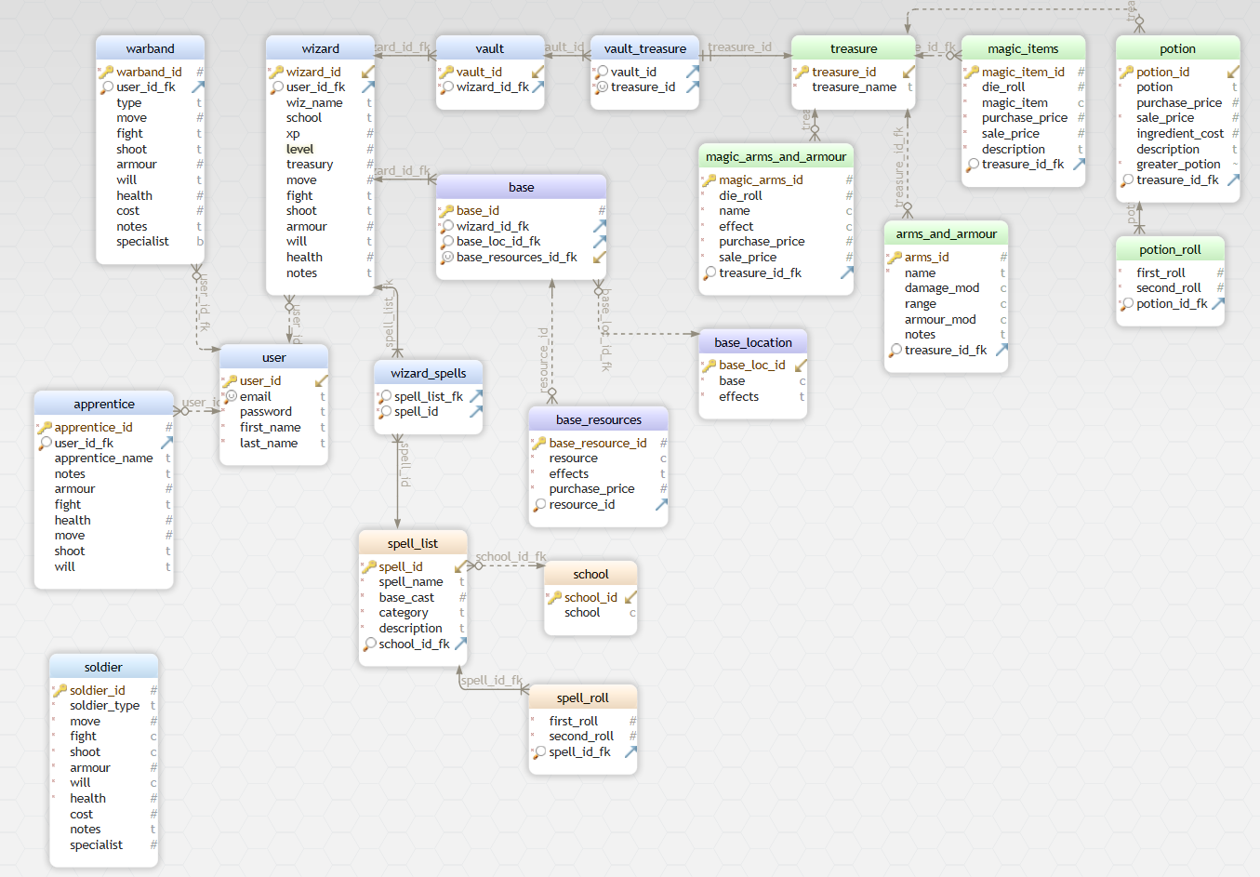
Entity Relationships

Slide 7
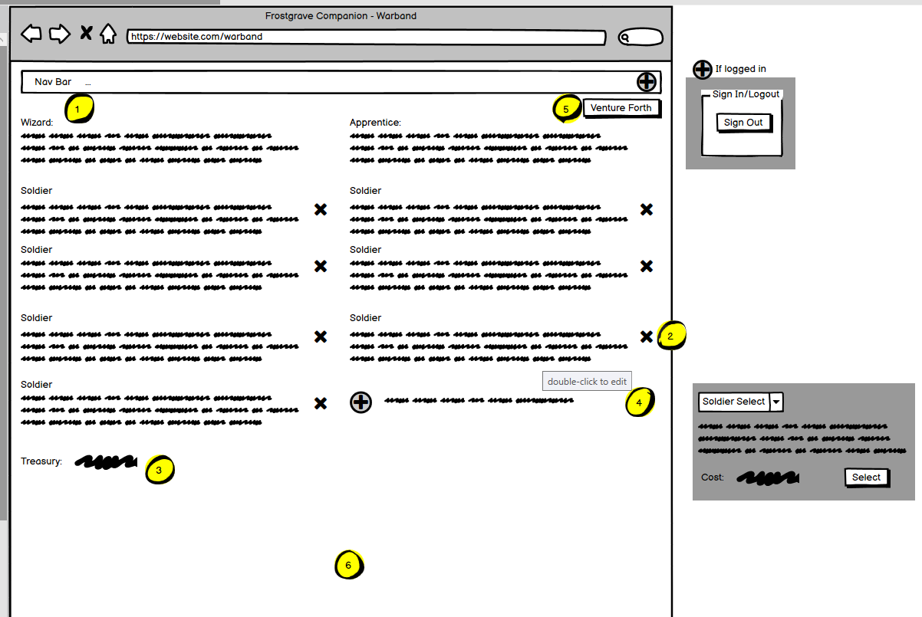
Functionality
The main goal was to have some sort of tracking for the users.
Wireframe of warband page.
This page would be used to add, modify, and list a user’s current warband.
Some of the functional code and page are on the next slide.

Slide 8
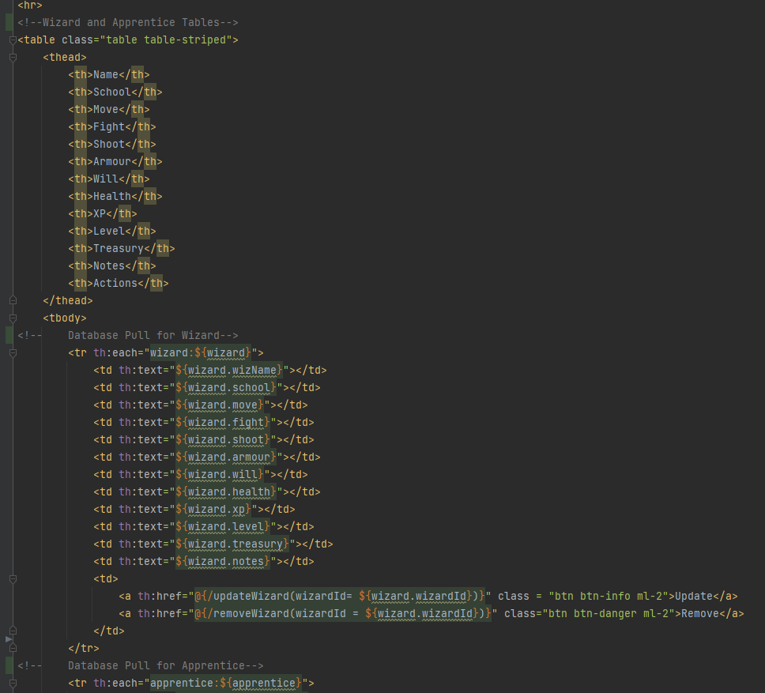
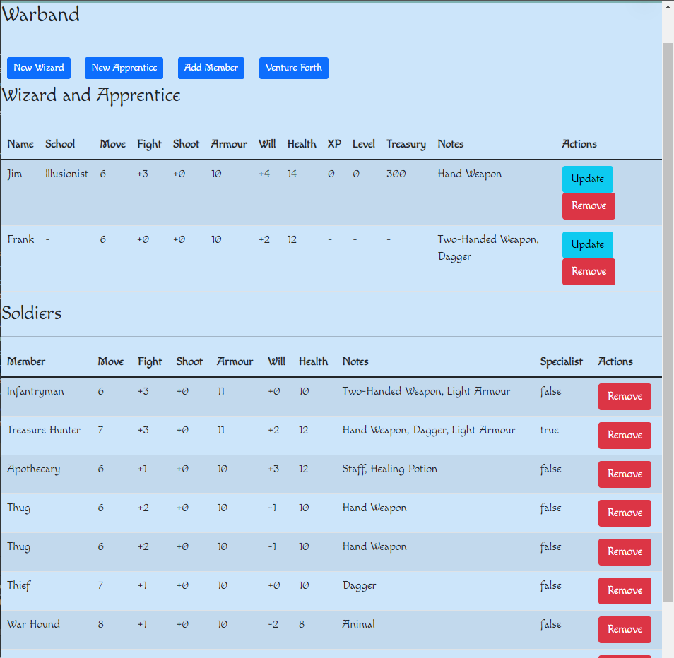
Functionality Contd.
http://localhost:8080/

Slide 9

Challenges
Overall feasibility
Big project
Entire book
Full-fledged game
Interlocking pieces
Layers
View
Controller
Service
Data
Thymeleaf

Slide 10

Handling
Big Project
Scaled down
Came up with a plan to get some things done now
Defined my MVP and worked towards it
Layers
Worked on understanding how those layers worked within one another
Thymeleaf
Practice
Online tutorials
Cohort
Assistance from fellow members
Oh… and Coffee

Slide 11

Extras
Injuries
Spells
Known
Cast value
Vault and Treasure
Scenario Select
Rules Reference
Creature Bestiary
Quick reference
Page numbers
Hosting for Mobile

Slide 12
Questions?

